Slide 1
TECHNICAL PAPERS AND ARTICLES

Slide 2
What are they?
They may present the results of studies done by researchers and scientists
They may give details and an overview of a specific subject or field
They may propose an idea and theory, or improve another one or criticize them

Slide 3
The General Form
Title
Authors and their affiliations
The issue details of the paper/article (DOI, volume, number and so on)
Abstract and Keywords
Introduction
Motivation
Related works / Literature review
The proposal / experiments / method used
The Results
Conclusion
References
CV summary

Slide 4
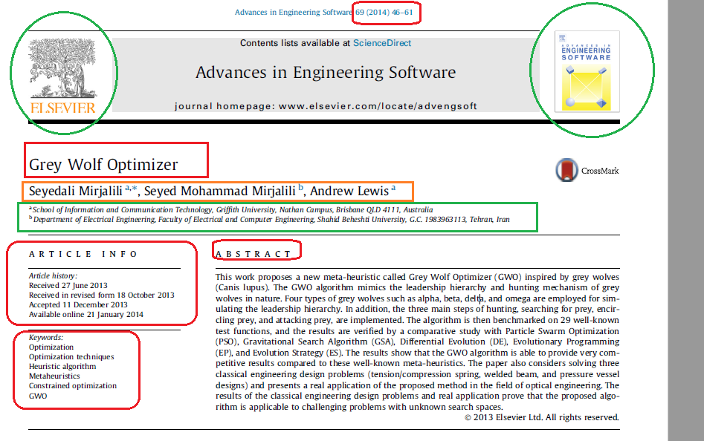

Slide 5
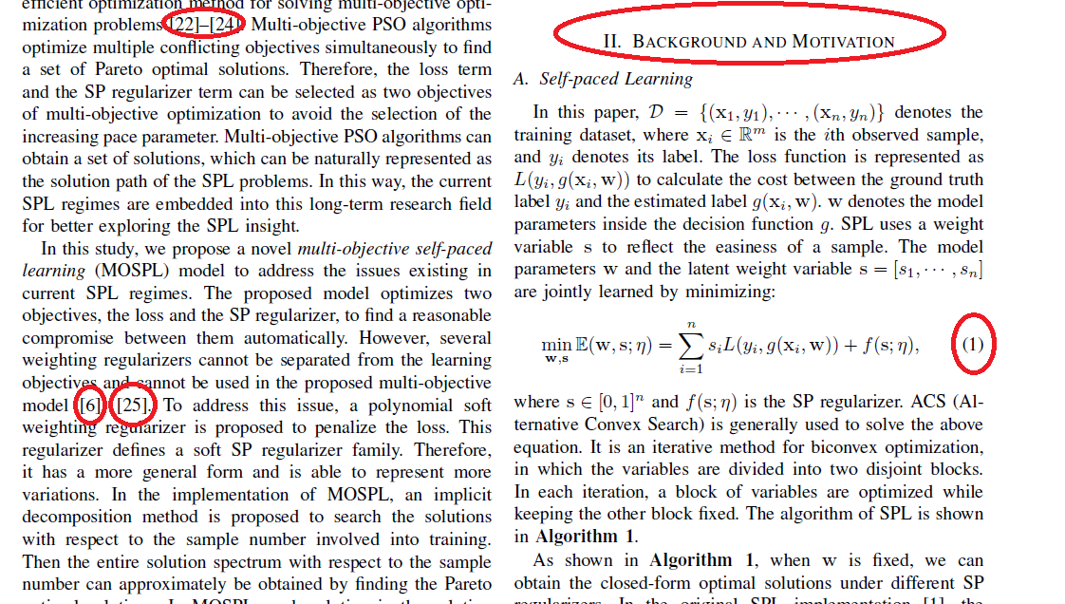

Slide 6
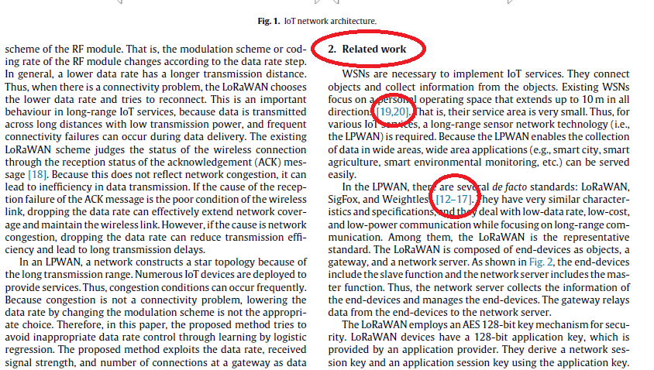

Slide 7
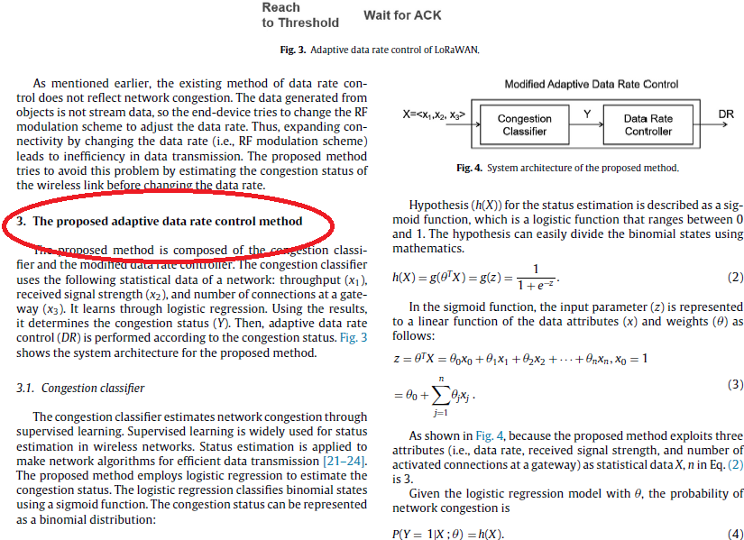

Slide 8
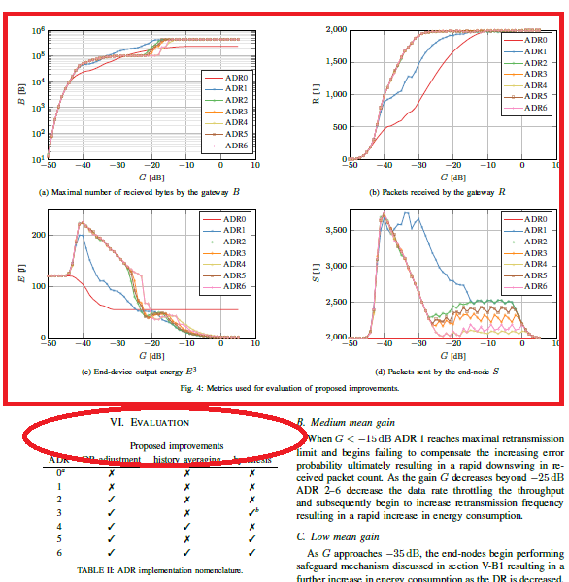

Slide 9
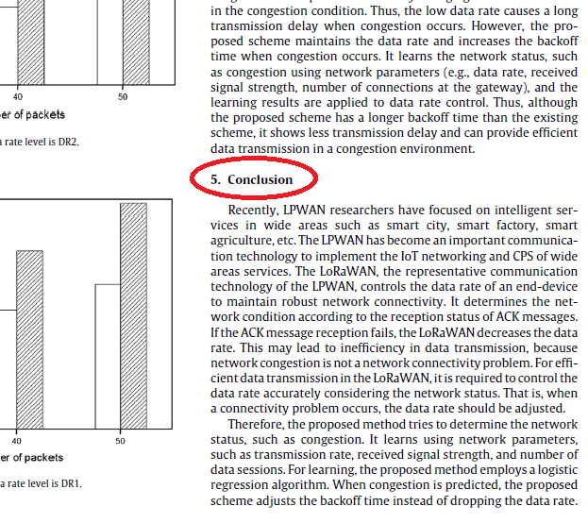

Slide 10
